Slide 1
ROAD TO STARWARZ
#Elias V. Fernandez III
#Mark Joseph Patao
#Ace Belen
#ABDELLA ADEM IBRAHIM

Slide 2
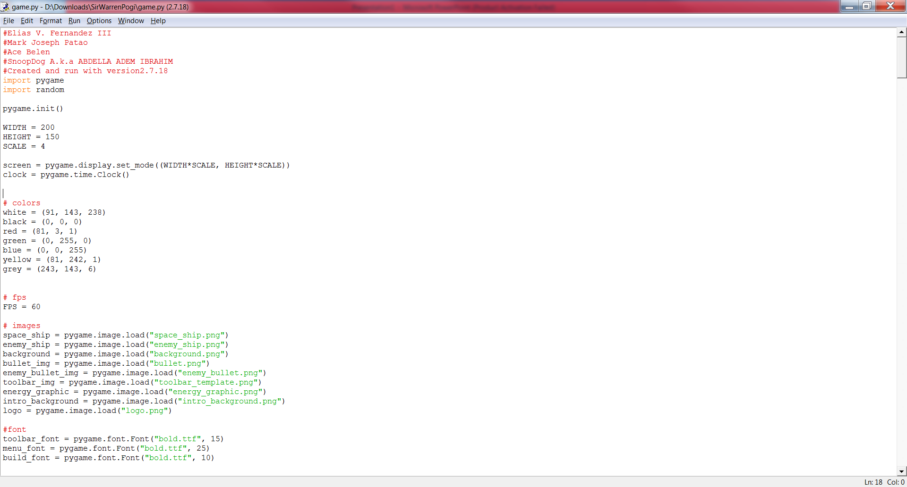
THIS IS THE PROGRAM

Slide 3
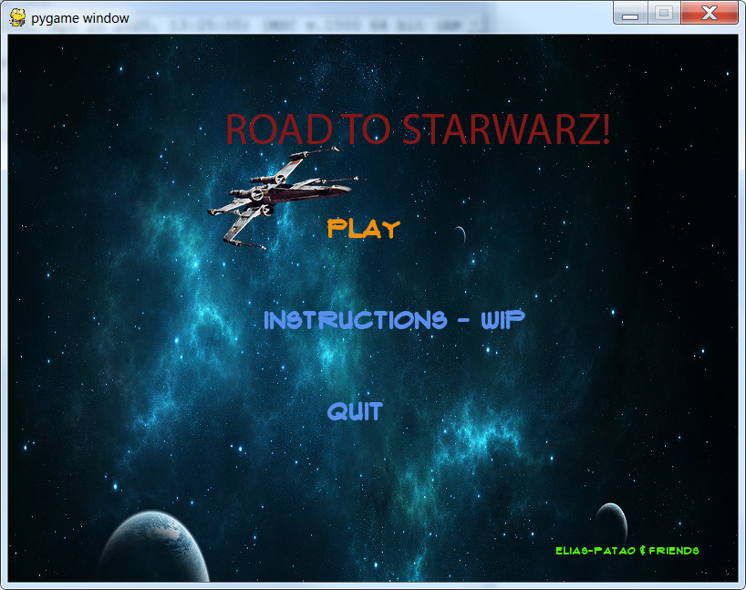
Main Menu

Slide 4
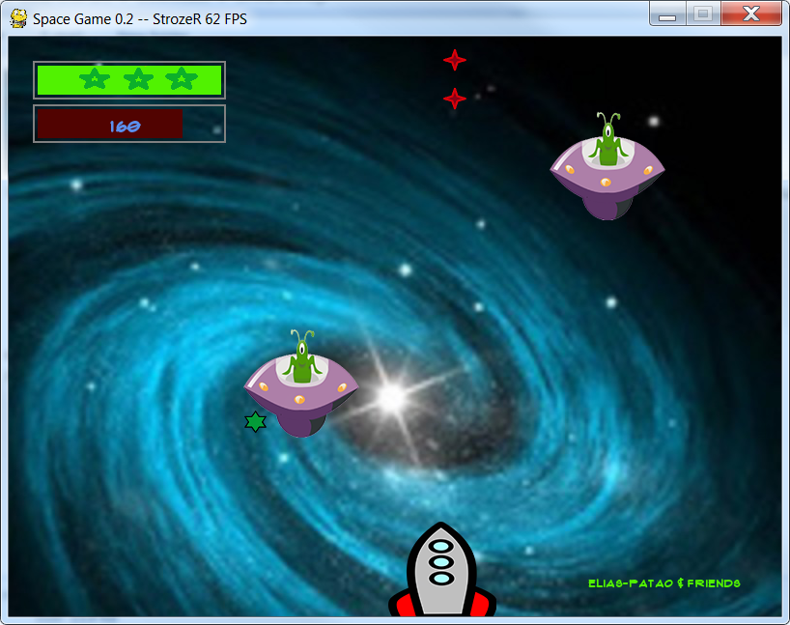
Game itself

